Slide 1
Basic I/O System Design
Course Teacher:
Md. Motaharul Islam, Ph.D.
Associate Professor
CSE Dept., BRAC University
Course ID: CSE - 341
Course Title: Microprocessors

Slide 2
Basic I/O System
 A Microprocessor is a great tool for solving problem but is
of little or no use if it can’t communicate with other devices.
 Input-Output devices (or peripherals) such as Keyboards, Mouse, LEDs, Displays are essential components of the microprocessor-based or microcontroller-based systems.
 Input
 Receive data from peripheral (i.e., device)
 Send data to computer
 Output
 Receive data from computer
 Send data to peripheral (i.e., device)

Slide 3
Basic I/O System
 8086 processor uses address bus pins AD[15:0] to locate an I/O port
 65,536 possible I/O ports
 Data transfer between ports and the processor occurs over data bus
 AL (or AX) is the processor register that takes input data (or provide output data)
Data bus
AL AX
8086
I/O
I/O
I/O
Address bus AD[15:0]

Slide 4
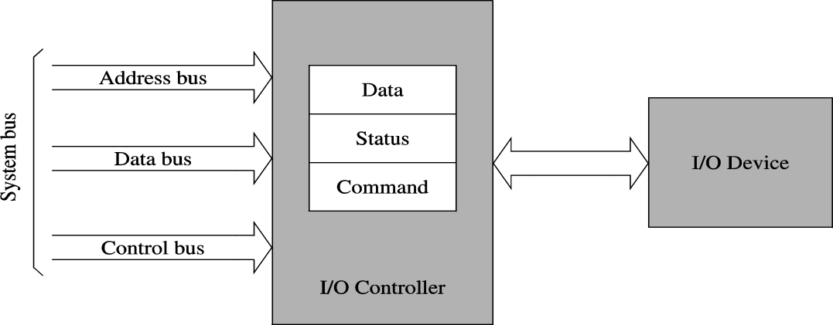
Basic I/O System
 I/O devices serve two main purposes
 To communicate with outside world
 To store data
 I/O Controller Chip (e.g., 8255) acts as an interface between the systems bus and I/O device.
 Relieves the processor of low-level details
 Takes care of electrical interface
 I/O Controller Chips have three types of registers
 Data
 Command
 Status

Slide 5
Block Diagram of Basic I/O System
 Access one port at a time called Serial Interfacing.
 To read (receive) binary data from an input peripheral
 MPU places the address of an input port on the address bus, enables the input port by asserting the RD signal, and reads data using the data bus.
 To write (send) binary data to an output peripheral
 MPU places the address of an output port on the address bus, places data on data bus, and asserts the WR signal to enable the output port.
 Remember:
 Writing to the port
 When the MPU sends out or transfers data to an output port
 Reading from the port
 When the MPU receives data from an input port

Slide 6
I/O Instructions
 IN is the instruction that reads information from an I/O device.
 OUT is the instruction that writes/sends data to an I/O device.
 In reality the data transfer takes place between the microprocessor accumulator (AL or AX) and the I/O device .
The I/O device may be identified using two methods:
Fixed address – A byte called p8 immediately following the opcode stores an 8 bit I/O address. This is called fixed because this is stored with the opcode in the ROM.
Variable address – Register DX holds a 16 bit I/O address. Because this can be changed.

Slide 7
I/O Instructions
 IN AL, p8 - A byte input from port p8 into AL
 IN AX, p8 - A word input from port p8 into AX
 IN AL, DX - A byte input from the port addressed by DX into AL
 IN AX, DX - A word input from the port addressed by DX into AX

Slide 8
I/O Instructions
 If p8 is used, only 8 bits are used thus the address or port number appears on lines A0-A7
 Hence, the first 256 I/O port addresses (00H – FFH) are accessed by both fixed and variable I/O instructions.
 If DX is used,16 bits thus the address or port number appears on lines A0-A15
 Addresses 0100H-FFFFH are only accessed by variable I/O Address instructions.

Slide 9
Accessing I/O Devices
 To communicate with an I/O device, we need-
 Access to various registers (data, status,…)
 This access depends on I/O address mapping,
Two basic ways
Memory-mapped I/O
Isolated I/O
 A protocol to communicate (to send data, …)
 Three types
Programmed I/O
Interrupt-driven I/O
Direct memory access (DMA)

Slide 10
I/O Address Mapping
 Memory Mapped I/O
 A device is mapped to a memory location. Sending data to the particular location causes interaction with the device.
 Reading and writing are similar to memory read/write with same address bus
 Uses same memory read and write signals
 Most processors use this I/O mapping
FFFFF
Memory addressing space
FFFF
I/O addressing space
00000
0000
FFFFF
I/O
Memory addressing
space
00000
Memory-mapped I/O

Slide 11
I/O Address Mapping
 Memory Mapped I/O
 Advantages:
 Less complication,
 Less circuitry
 Less decoding
 No need to use special signal
 MOV Instruction can also be used instead of IN and
OUT
 Disadvantage:
 A portion of the memory system is used as the I/O Map

Slide 12
I/O Address Mapping
 Isolated I/O
 Separate I/O address space
 Separate I/O read and write signals are needed
 I/O read – IORC
Memory
FFFFF
I/O
FFFF
64K X 8
 I/O write – IOWC
 This is the most common form of I/O transfer technique used with Intel processors.
 Pentium supports isolated I/O of 64 KB address space.
0000
1M X 8
00000

Slide 13
I/O Address Mapping
 Isolated I/O
 On Personal computers Isolated I/O is used.
 8 bit port addresses are used to access devices located on system board.
 16 bit port address are used to access serial and parallel ports as well as video and disk drive systems.

Slide 14
I/O Address Mapping
 Isolated I/O
 Advantages:
 In this system no memory is wasted for I/O mapping.
 Disadvantage:
 Instructions IN and OUT need to be used to perform data transfer.
 Separate signals are also needed to interact with the I/O devices which separate it from normal memory access instructions.

Slide 15
Accessing I/O Ports in 8086
 Register I/O instructions
IN accumulator, port8;direct format
Useful to access first 256 ports
IN accumulator,DX ;indirect format
DX gives the port address
 Simple MOV instruction can be used instead of IN and OUT.

Slide 16
Accessing I/O Ports in 8086
 Addressing Space
Accessing directly by instructions
IN | AL, | 80H
IN | AX, | 6H
OUT | 3CH, | AL
OUT | 0A0H, | AX
FFFF
Accessed through DX
Accessing through DX
IN AL, DX
IN AX, DX
OUT DX, AL
OUT DX, AX
00FF
00F8
Accessed directly by instructions
0000

Slide 17
I/O Data Transfer Techniques
 Data transfer involves three basic techniques
 Programmed I/O
 DMA
 Interrupt-driven I/O

Slide 18
Programmed I/O
 CPU has direct control over I/O
 Sensing status
 Read/write commands
 Transferring data
 CPU waits for I/O module to complete operation
 Programmed I/O Wastes CPU time
 Addressing I/O Devices
 Under programmed I/O data transfer is very like memory access (CPU viewpoint)
 Each device given a unique identifier
 CPU commands contain identifier (address)

Slide 19
Direct Memory Access (DMA)
 Interrupt driven and programmed I/O require active CPU intervention
 Hence, the data transfer rate is limited
 For typical microprocessors 1 (one) byte of data transfer
between RAM and I/O take 5 – 10 microseconds.
 Hence, CPU is tied up
 DMA is the answer
 DMA is more efficient for transferring large volumes of data.

Slide 20
Direct Memory Access (DMA)
 DMA doesn’t make use of the microprocessor to do the transfer so who is going to do the READ and WRITE operation?
 A DMA Controller Chip is may be built into the microprocessor or may be found external.
 We can see that the DMA controller has to perform operations that are very similar to operations performed by a microprocessor.
 They are thus generally designed and built by microprocessor manufacturers.

Slide 21
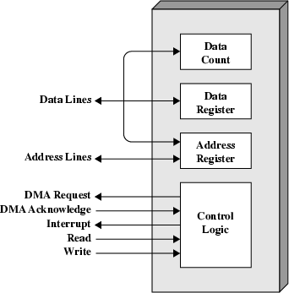
Typical DMA Module Diagram

Slide 22
DMA Operation – Detail Steps
 CPU tells DMA controller:-
 Read/Write
 Device address
 Starting address of memory block for data
 Amount of data to be transferred
 CPU carries on with other work
 DMA controller deals with transfer
 DMA controller sends interrupt when finished

Slide 23
Direct memory access
Direct memory access (DMA) is a process in which an external device takes
over the control of system bus from the CPU.
DMA is for high-speed data transfer from/to mass storage peripherals, e.g. harddisk
drive, magnetic tape, CD-ROM, and sometimes video controllers.
For example, a hard disk may boasts a transfer rate of 5 M bytes per second, i.e.
1 byte transmission every 200 ns. To make such data transfer via the CPU is
both undesirable and unnecessary.
The basic idea of DMA is to transfer blocks of data directly between memory and
peripherals. The data don’t go through the microprocessor but the data bus is
occupied.
“Normal” transfer of one data byte takes up to 29 clock cycles. The DMA transfer
requires only 5 clock cycles.
Nowadays, DMA can transfer data as fast as 60 M byte per second.

Slide 24
DMA controller
A DMA controller interfaces with several peripherals that may request DMA.
The controller decides the priority of simultaneous DMA requests,
communicates with the peripheral and the CPU, and provides memory
addresses for data transfer.
8237 is DMA controller.
The 8237 is a 4-channel device. Each channel is dedicated to a specific
peripheral device and capable of addressing 64 K bytes section of memory.

Slide 25
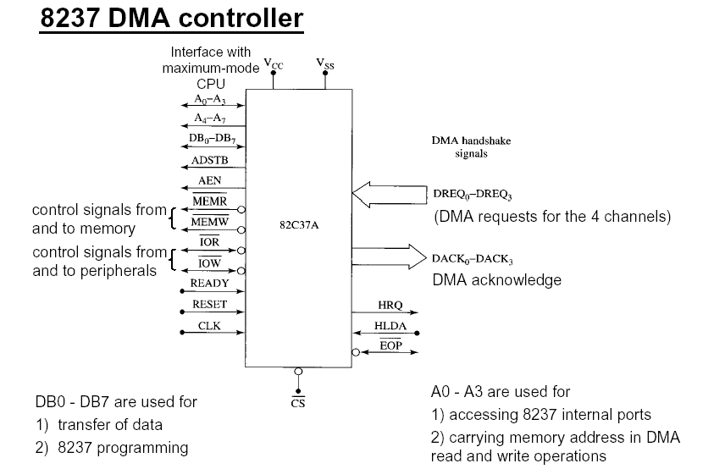

Slide 26
DMA
important signal pins:
• DREQ3 – DREQ0 (DMA request): Used to request a DMA transfer for a particular DMA channel.
• DACK3 – DACK0 (DMA channel acknowledge): Acknowledges a channel DMA request from a device.
• HRQ (Hold request): Requests a DMA transfer.
• HLDA (Hold acknowledge) signals the 8237 that the microprocessor has relinquished control of the address, data and control buses.

Slide 27
DMA
Some important signal pins:
• AEN (Address enable): Enables the DMA address latch connected to the 8237 and disable any buffers in the system connected to the microprocessor. (Use to take the control of the address bus from the microprocessor)
ADSTB (Address strobe): Functions as ALE to latch address during the DMA transfer.
• EOP (End of process): bi direction, Signals the end of the DMA process.
• IOR (I/O read): bi-dir, Used as an input strobe to read data from the 8237 during programming and used as an output strobe to read data from the port during a DMA write cycle.

Slide 28
DMA
Some important signal pins:
IOW (I/O write): bi-dir Used as an input strobe to write data to the 8237 during programming and used as an output strobe to write data to the port during a DMA read cycle.
MEMW (Memory write): Used as an output to cause memory to write data during a DMA write cycle.
MEMR (Memory read): Used as an output to cause memory to read data during a DMA read cycle
A3 – A0 : address pins select an internal register during programming and provide part of the DMA transfer address during DMA operation.

Slide 29
DMA
Some important signal pins:
A7 – A4 : address pins are outputs that provide part of the DMA transfer address during a DMA operation.
DB0 – DB7 : data bus, connected to microprocessor and are used during the programming DMA controller.

Slide 30
DMA
Basic DMA operation :
The HOLD signal is a bus request signal which asks the microprocessor to release control of the buses after the current
bus cycle.
The HLDA signal is a bus grant signal which indicates that the
microprocessor has indeed released control of its buses by
placing the buses at their high-impedance states.

Slide 31
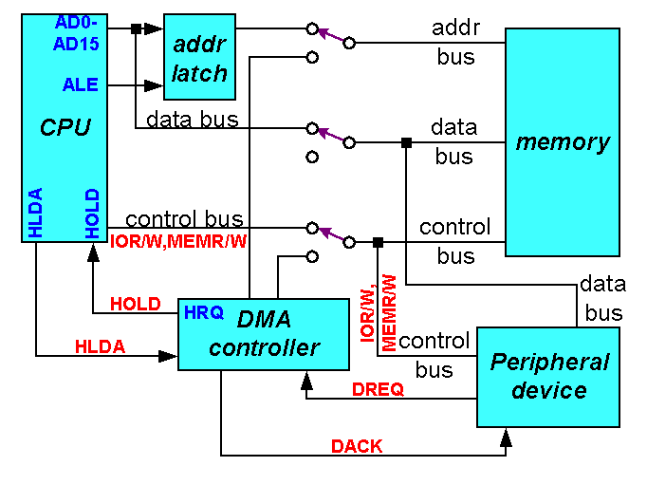
CPU having the control over the bus:

Slide 32

When DMA operates:

Slide 33
DMA
Cascade Mode:
more than one 8237A together for simple system
expansion.
The HRQ and HLDA signals from the additional 8237A are connected to the DREQ and
DACK signals of a channel of the initial 8237A.
This allows the DMA requests of the additional device to
propagate through the priority network circuitry of the preceding device.

Slide 34
Bus Interfaces

Slide 35
CPU-Memory-I/O Architecture
Memory
I/O
I/O
CPU
module
device
“CPU bus”
or
“System bus”
“I/O bus”
“Bus interface”

Slide 36
I/O Buses and Interfaces
 There are many “standards” for I/O buses and interfaces
 Standards allow “open architectures”
 Many vendors can provide peripheral (I/O) devices for many
different systems
 Most systems support several I/O buses and I/O interfaces

Slide 37
Expansion Buses
 These are “slots” on the motherboard
 Examples
 ISA – Industry Standard Architecture
 PCI – Personal Component Interconnect
 EISA – Extended ISA
 SIMM – Single Inline Memory Module
 DIMM – Dual Inline Memory Module
 MCA – Micro-Channel Architecture
 AGP – Accelerated Graphics Port
 VESA – Video Electronics Standards Association
 PCMCIA – Personal Computer Memory Card International Association (not just memory!)

Slide 38
3 ISA
slots
5 PCI slots
Pentium CPU
6 SIMM
slots
2 DIMM
slots

Slide 39
Disk Interfaces
 Examples
 ATA – AT Attachment (named after IBM PC-AT)
 IDE – Integrated Drive Electronics (same as ATA)
 Enhanced IDE
 Encompasses several older standards (ST-506/ST-412, IDE, ESDI,ATA- 2,ATA-3,ATA-4)
 Floppy disk
 SCSI – Small Computer Systems Interface
 ESDI – Enhanced Small Device Interface (mid-80s, obsolete)
 PCMCIA

Slide 40
External Buses
 Examples
 Parallel – sometimes called LPT (“line printer”)
 Serial – typically RS232C (sometimes RS422)
 PS/2 – for keyboards and mice
 USB – Universal Serial Bus
 IrDA – Infrared Device Attachment
 FireWire – new, very high speed, developed by IEEE

Slide 41
Communications Buses
 For connecting systems to systems
 Parallel/LPT
 special purpose, e.g., using special software (Laplink) to transfer data between systems
 Serial/RS232C
 To connect a system to a voice-grade modem
 Ethernet
 To connect a system to a high-speed network

Slide 42
PCI
 Peripheral Component Interconnect
 Also called “Local Bus”
 History
 Developed by Intel (1993)
 Very successful, widely used
 Much faster than ISA
 Gradually replacing ISA
 Configuration
 Parallel, multi-drop

Slide 43
PCI
 Used for…
 Just about any peripheral
 Can support multiple high-performance devices
 Graphics, full-motion video, SCSI, local area networks, etc.
 Specifications
 64-bit bus capability
 Usually implemented as a 32-bit bus
 Runs at 33 MHz or 66 MHz
 At 33 MHz and a 32-bit bus, data rate is 133 Mbytes/s

Slide 44
AGP
 Accelerated Graphics Port
 History
 First appeared on Pentium II boards
 Developed just for graphics (especially 3D graphics)
 Configuration
 Parallel, point-to-point (only one AGP port / system)
 Specifications
 Data rates up to 532 Mbytes/s (that’s 4x PCI!)

Slide 45
Identifying ISA, PCI, & AGP slots
 Here’s an image to help in identifying slots
Back of computer
AGP slot
PCI slot
ISA slot

Slide 46
Thank You !!
36

